Slide 1
Al-Farabi Kazakh National University
Higher School of Medicine
Introduction to molecular biology
Notes:
Weaver, PART I

Slide 2
Teacher by Molecular Biology
Pinsky Ilya Vladimirovich, PhD, Biotechnology

Slide 3
LEARNING OUTCOMES As a result of the lesson you will be able to:
describe the Chargaff, Griffith, Avery-MacLeod-McCarty, Hershey-Chase experiments and explain their significance;
explain informational properties of macromolecules;
explain the central dogma of molecular biology;
briefly discuss the role of molecular biology in medicine.

Slide 4
Molecular biology
Definition: the study of genetic structure and functions at the molecular level (the science about structure and functions of nucleic acids – DNA and RNA).

Slide 5
Readings: Russell, pp. 9-14; Hartwell, pp. 163-168; Watson, pp. 21-33.

Slide 6
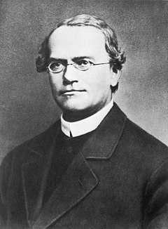
Gregor Mendel (1865)
Gregor Mendel conducted his experiments with peas showing that heredity is transmitted in discrete units. He pollinated plants by himself until they bred true – giving rise to similar characteristics generation after generation. He studied easily distinguishable characteristics like the color and texture of the peas, the color of the pea pods and flowers, and the height of the plants.

Slide 8
Thomas Morgan (1910)
In 1910, Thomas Hunt Morgan performed an experiment at Columbia University, that helped identify the role chromosomes play in heredity. Morgan was breeding Drosophila, or fruit flies. After observing thousands of fruit fly offspring with red eyes, he obtained one that had white eyes. Morgan began breeding the white-eyed mutant fly and found that in one generation of flies, the trait was only present in males. Through more breeding analysis, Morgan found that the genetic factor controlling eye color in the flies was on the same chromosome that determined sex. That result indicated that eye color and sex were both tied to chromosomes and helped Morgan establish that chromosomes carry the genes that allow offspring to inherit traits from their parents.

Slide 9
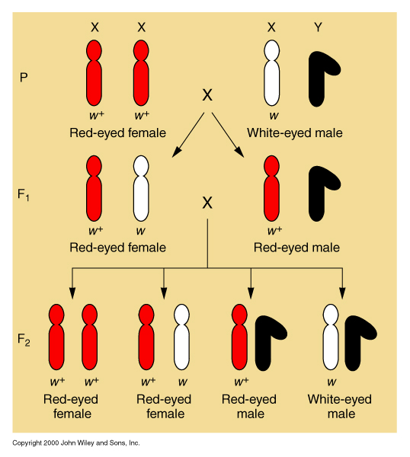
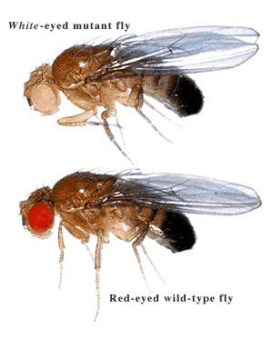
Chromosomal theory of inheritance

Slide 10
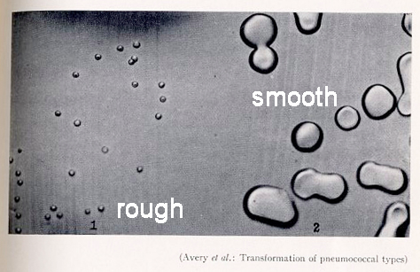
Frederick Griffith (1928): the transforming principle
Griffith used two strains of Streptococcus pneumoniae. These bacteria infect mice, Griffith's favorite animals. He used a type III-S (smooth) and type II-R (rough) strain.
The III-S strain covers itself with a polysaccharide capsule that protects it from the host's immune system. This means that the host will die.
The II-R strain does not have that protective shield around it and is killed by the host's immune system.

Slide 11
Friedrich Miescher (1869)
In 1869, Friedrich Miescher isolated "nuclein," DNA with associated proteins, from cell nuclei. He was the first to identify DNA as a distinct molecule.
As a student, Miescher was given the task of researching the composition of lymphoid cells — white blood cells. These cells were difficult to extract from the lymph glands, but they were found in great quantities in the pus from infections. Miescher collected bandages from a nearby clinic and washed off the pus. He experimented and isolated a new molecule – nuclein – from the cell nucleus. He determined that nuclein was made up of hydrogen, oxygen, nitrogen and phosphorus and there was an unique ratio of phosphorus to nitrogen.

Slide 12
Oswald Avery, Colin MacLeod, Maclyn McCarty (1944): Griffith’s experiment revisited
In 1944, three Canadian and American researchers, Oswald Avery, Maclyn McCarty, and Colin MacLeod, set out to identify Griffith's "transforming principle."

Slide 13
Erwin Chargaff (1949)
Chargaff analyzed the DNA of different species, determining its composition of A, T, C, and G bases. He made several key observations:
A, T, C, and G were not found in equal quantities (as some models at the time would have predicted)
The amounts of the bases varied among species, but not between individuals of the same species
The amount of A always equalled the amount of T, and the amount of C always equalled the amount of G (A = T and G = C)
These findings, called Chargaff's rules, turned out to be crucial to Watson and Crick's model of the DNA double helix.

Slide 14
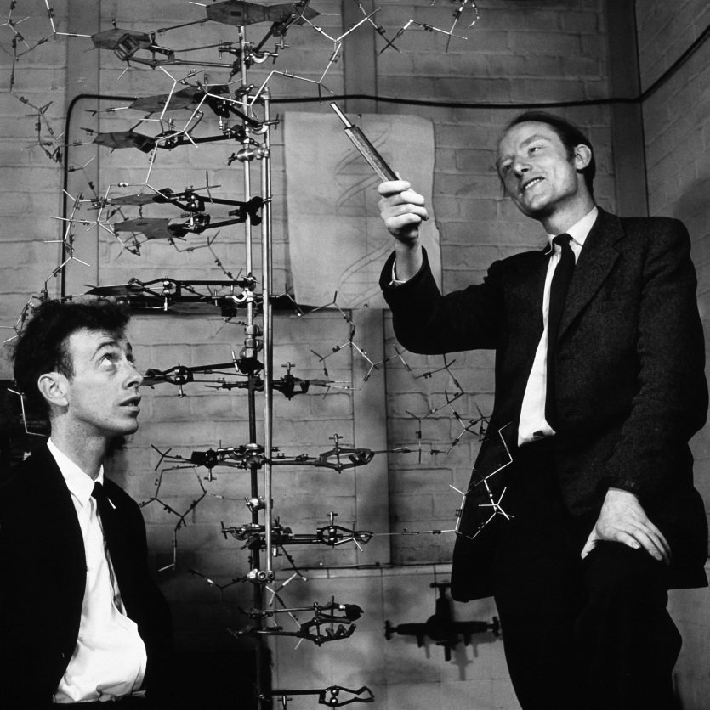
James Watson, Francis Crick
In the early 1950s, Watson and Crick mostly collected and analyzed existing pieces of data, putting them together in new and insightful ways. Some of their most crucial clues to DNA's structure came from X-ray crystallography.

Slide 15
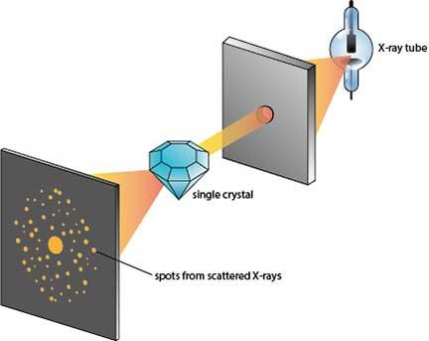
X-ray diffraction
X-ray diffraction is the elastic scattering of x-ray photons by atoms in a periodic lattice.
The technique relies on the dual wave/particle nature of X-rays to obtain information about the structure of crystalline materials. A primary use of the technique is the identification and characterization of compounds based on their diffraction pattern.

Slide 16
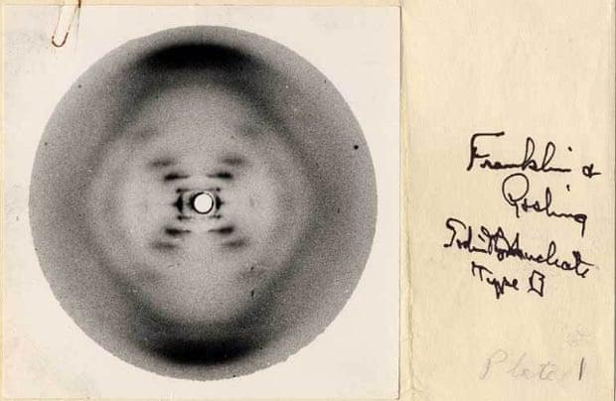
Rosalind Franklin: photo 51
Franklin was an expert in a powerful technique for determining the structure of molecules, known as X-ray crystallography.
When the crystallized form of a DNA is exposed to X-rays, some of the rays are deflected by the atoms in the crystal, forming a diffraction pattern that gives clues about the molecule's structure.

Slide 17
George Beadle, E. L. Tatum (1941)
The one gene, one enzyme hypothesis is the idea that each gene encodes a single enzyme. Today, we know that this idea is generally (but not exactly) correct.
Sir Archibald Garrod, a British medical doctor, was the first to suggest that genes were connected to enzymes.
Beadle and Tatum confirmed Garrod's hypothesis using genetic and biochemical studies of the bread mold Neurospora.
Beadle and Tatum identified bread mold mutants that were unable to make specific amino acids. In each one, a mutation had "broken" an enzyme needed to build a certain amino acid.

Slide 18
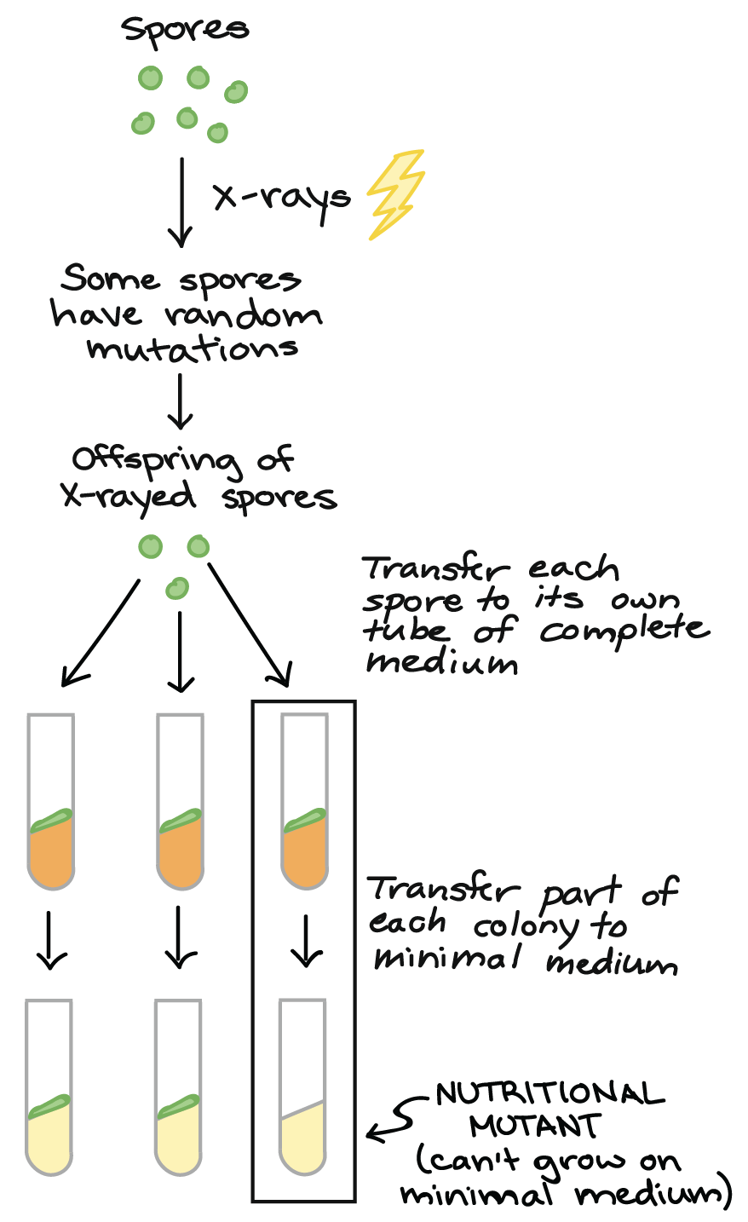
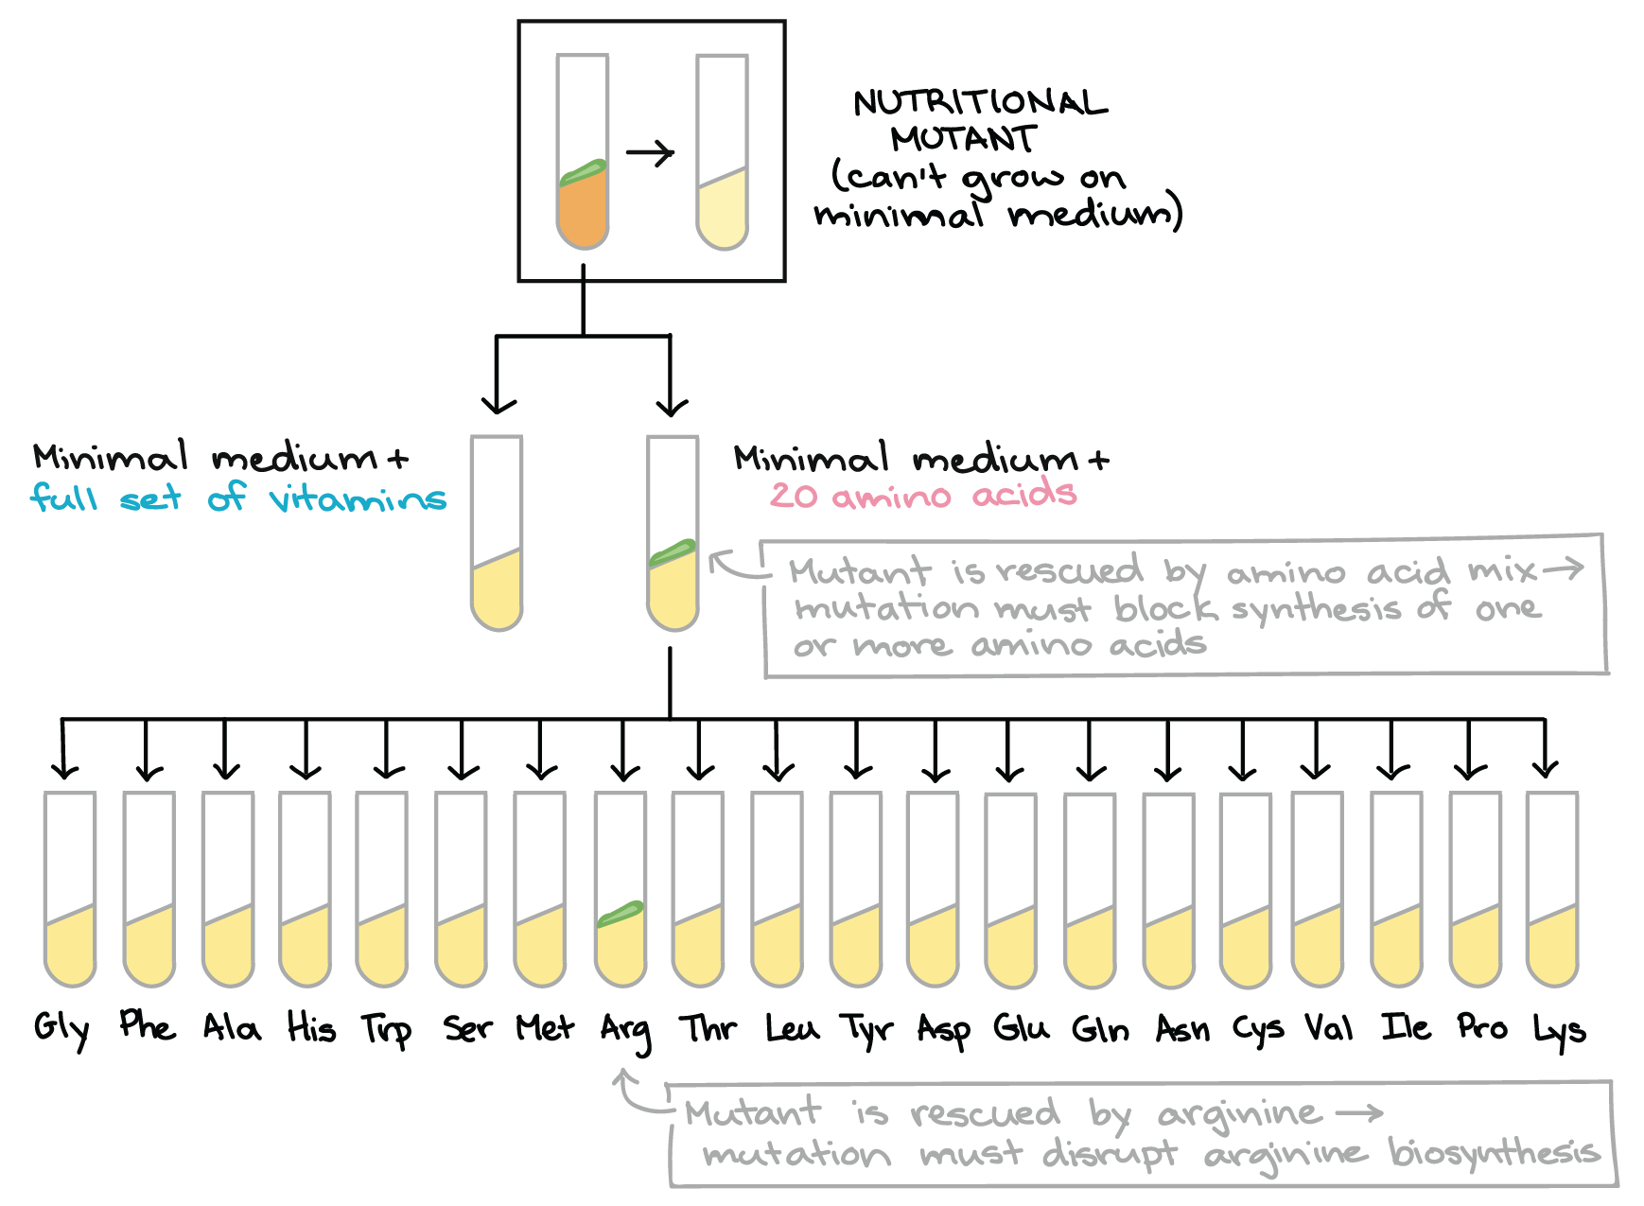
George Beadle, E. L. Tatum (1941)

Slide 19
Sydney Brenner, François Jacob,
Matthew Meselson (1961)
In 1961 South African molecular biologist Sydney Brenner working at the Cavendish Laboratory in Cambridge, French molecular biologist François Jacob at the Institut Pasteur in Paris, and American molecular biologist Matthew Meselson at Caltech in Pasadena. They showed that short-lived RNA molecules that they called messenger RNA (mRNA) carry the genetic instructions from DNA to structures in the cell called ribosomes. They also demonstrated that ribosomes are the site of protein synthesis.

Slide 20
Marshall Nirenberg, Gobind Khorana (1966)
In 1961 Nirenberg and his group deciphered the entire genetic code by matching amino acids to synthetic triplet nucleotides. They found that there is redundancy in that some amino acids are encoded by more than one codon and some codons are "punctuation marks" in the mRNA message. Nirenberg and his group also showed that with few exceptions, the genetic code was universal to all life on earth. Nirenberg shared the 1968 Nobel Prize in Physiology or Medicine with Har Gobind Khorana and Robert Holley. Khorana also worked on cracking the genetic code; Holley was the first that deciphered the sequence of tRNA and determine its structure.

Slide 21
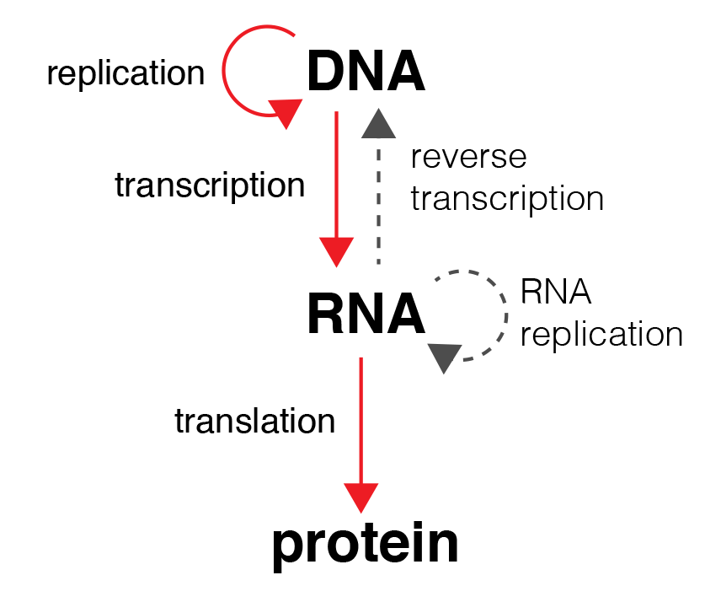
The central dogma of molecular biology

Slide 22
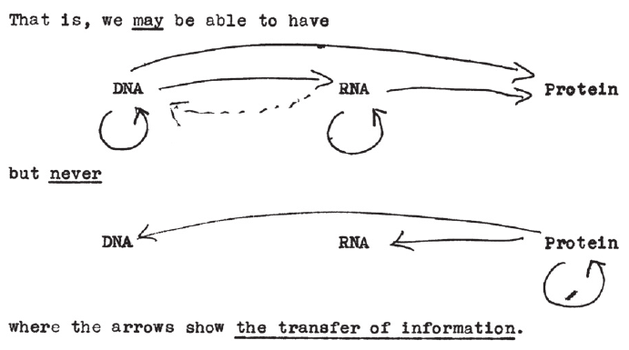
The central dogma of molecular biology
Francis Crick’s unpublished 1956 sketch.

Slide 23
The role of molecular biology in medicine
Molecular biotechnology:
microbiological synthesis of medical drugs and additives
production of vaccines
gene engineering
Molecular medicine:
molecular diagnostics (ELISA, PCR, electrophoresis, restriction analysis and etc.)
gene therapy in vivo and ex vivo, genome editing and etc.
nanotechnologies and biocompatible materials in medicine

Slide 24
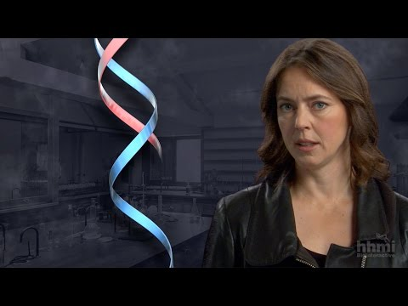
Video: DNA double helix
Notes:
Pre-class home assignment!

